Slide 1
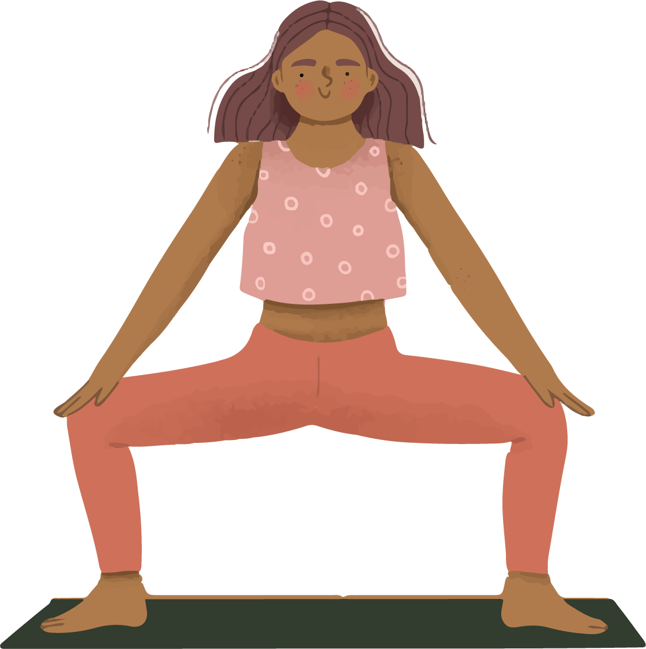
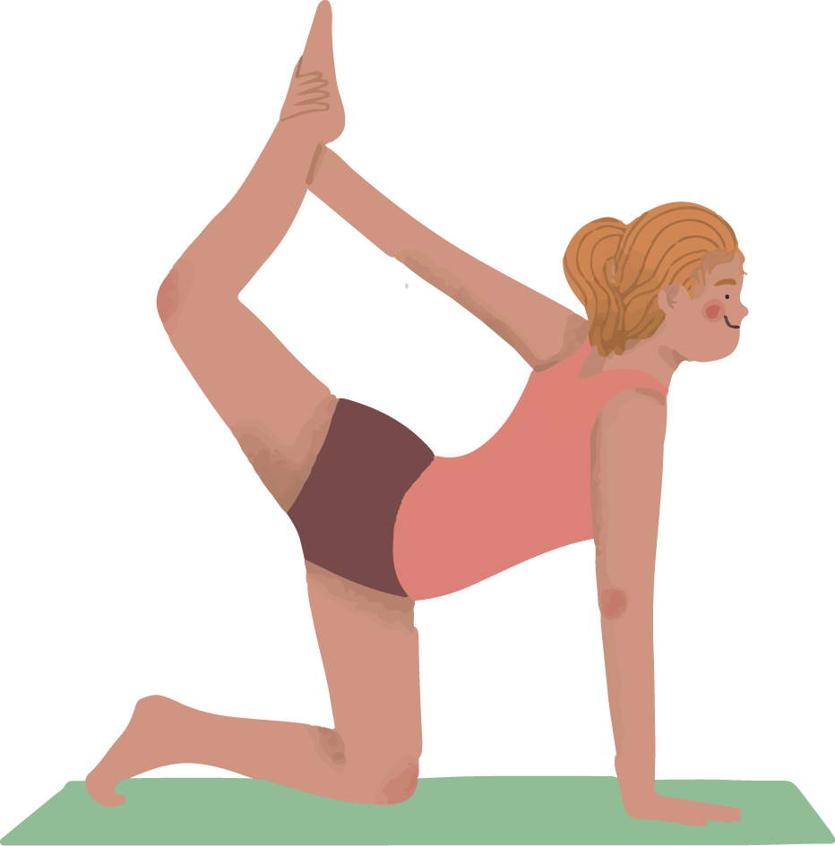
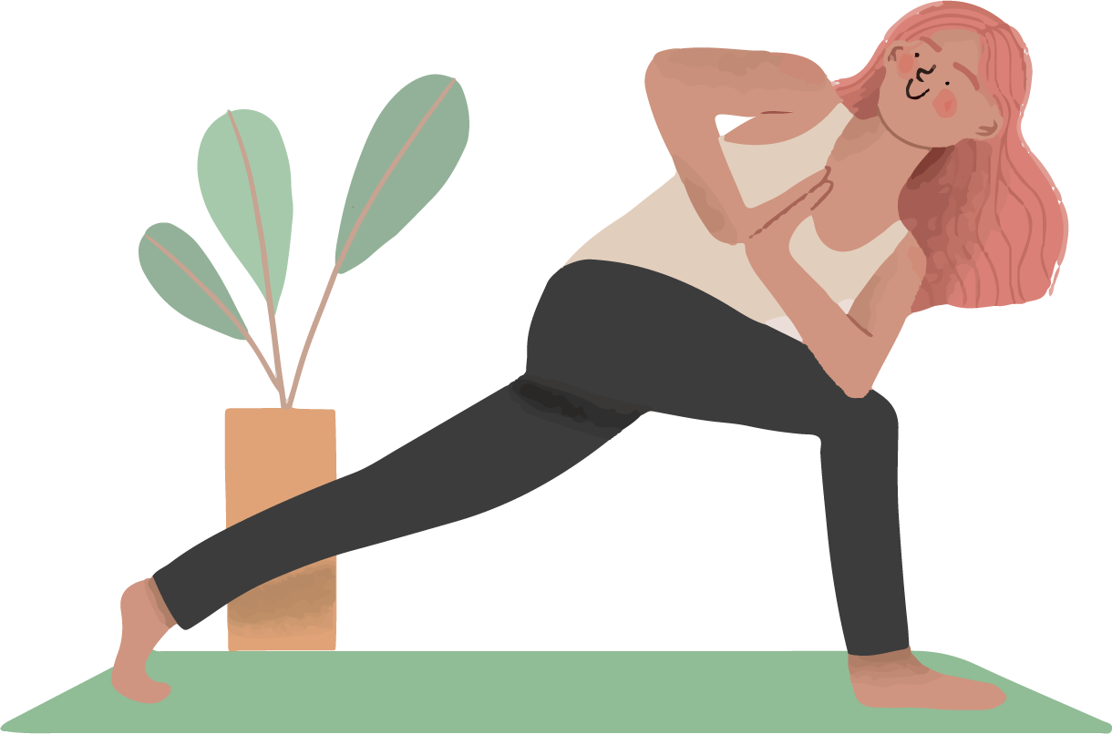
Yoga App
YO
GA

Slide 2
Table of contents
01
03
02
04
Theoretical lesson
Tips of the topic
You can describe the topic of the section here
You can describe the topic of the section here
Features of the topic
Practical exercise
You can describe the topic of the section here
You can describe the topic of the section here

Slide 3
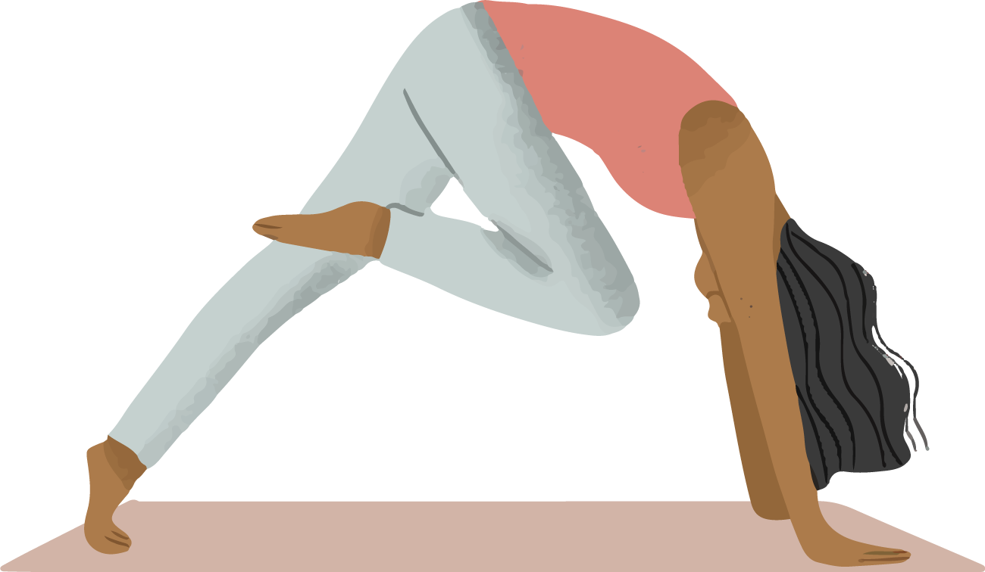
App Concepts
Yo
ga
In this application we are going to provide information regarding the yoga as well as meditation like different types of asana and benefits of doing yoga and how to do it home itself etc..

Slide 4
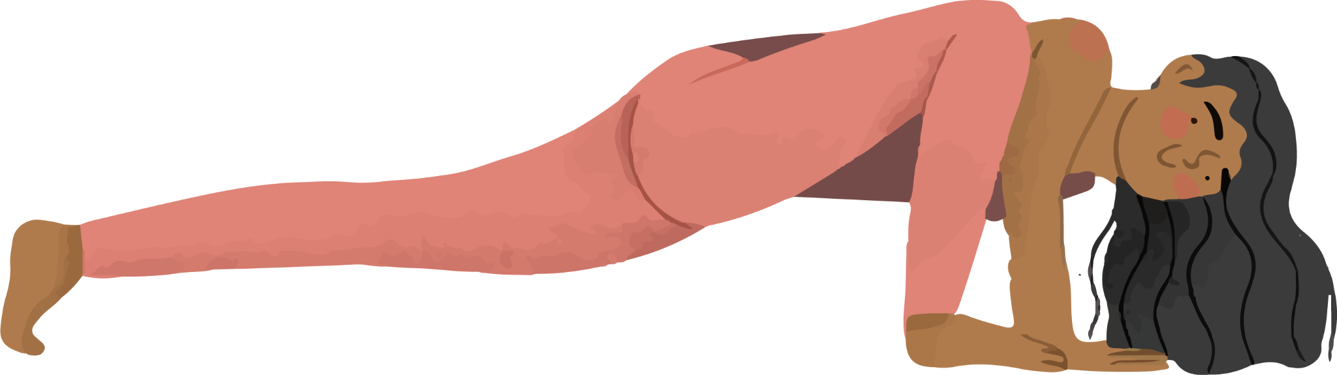
What is this App about ?
Modern forms
Principles
App gives information about modern forms of yoga.
This also tells about the life principles which are important for personal development.
Practice
Meditation
App helps you to practice in the home itself and provide necessary information.
It also consists of meditation training and it is main objective is to reduce stress.

Slide 5
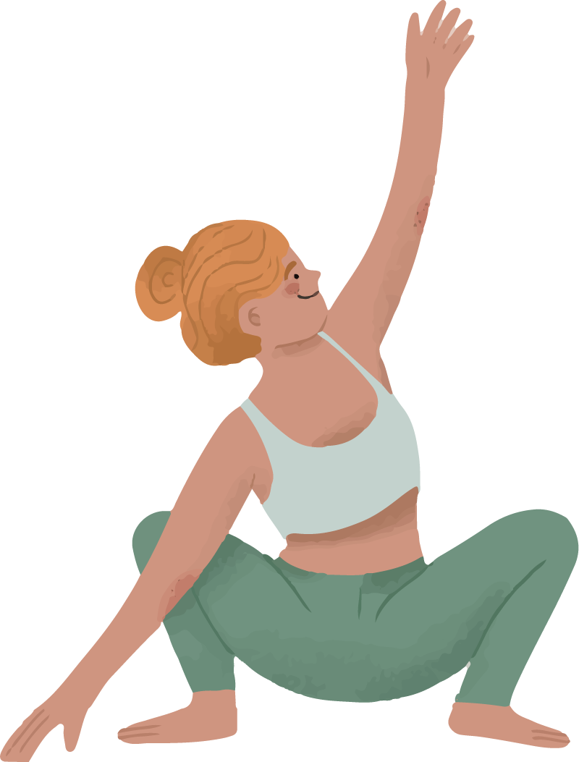
Stages
Application gives complete information about stages, it starts from beginner to advance to access the advance level feature people need to purchase the subscription.

Slide 6

Benefits of Yoga
Improves Strength
Yoga Relaxes You
Back Pain Relief
Boost Energy and Mood
Heart Health
Manage Stress

Slide 7


Thank You

